Slide 1
HORIZONS
Notes:
Hello, I’m Bryce Adelstein Lelbach.
I work on the C++ programming language. I’m the chair of the Standard C++ Library Evolution group, which designs and standardizes the C++ Standard Library. I also chair the American committee for programming language standards and serve as editor for the INCITS inclusive terminology standards and guidelines.
I’m a Principal Architect at NVIDIA, where I drive our strategy for HPC and quantum programming models, C++ compilers, and C++ libraries.

Slide 2
C++23 is coming!
More ranges
Formatted output
mdspan
expected
import std
Deducing this
Notes:
The next C++ standard, C++23, is feature complete and nearly done. We’ll finalize it in February 2023.
There’s a lot of exciting changes coming in C++23 – to name a few:
Enhancements and additions to ranges, which were added in C++20.
Formatted output.
mdspan, a multi-dimensional array abstraction.
expected, a new error reporting paradigm.
Standard library modules, and
Deducing this.

Slide 3
On The Horizon For
Notes:
But today, I want to look beyond C++23.
I want to tell you about three features that we’re working on – features that I think will revolutionize how we write C++ code.

Slide 4
On The Horizon For
Reflection
Notes:
Those features are reflection…

Slide 5
On The Horizon For
Reflection
Pattern Matching
Notes:
…pattern matching…

Slide 6
On The Horizon For
Reflection
Pattern Matching
Senders
Notes:
…and senders.

Slide 7
Program
Metaprogram
Notes:
First, let’s talk about reflection.
Metaprogramming is the craft of creating or modifying programs as the product of other programs. Reflective metaprogramming is metaprogramming that incorporates data from the program being modified.

Slide 8
Program
Metaprogram
Reflection
Injection
Notes:
There are 3 components to reflective metaprogramming:
Reflection – Extracting information from the program.
Compile time programming – Tools for manipulating that information.
Injection – Inserting new program entities.

Slide 9
template <typename T> requires is_enum_v<T>
constexpr string to_string(T value) {
template for (constexpr meta::info e : meta::members_of(^T))
if ([:e:] == value)
return meta::name_of(e);
return "<unnamed>";
}
Notes:
Let’s look at a simple example – a function that takes an enumerator and returns its name as a string.
We’re using a few new C++ constructs here.

Slide 10
template <typename T> requires is_enum_v<T>
constexpr string to_string(T value) {
template for (constexpr meta::info e : meta::members_of(^T))
if ([:e:] == value)
return meta::name_of(e);
return "<unnamed>";
}
^name-or-postfix-expr
The reify operator.
entity -> reflection
Notes:
The reify operator takes a C++ entity – a function, a struct, an enumerator, a variable, a namespace – and produces a reflection.
A reflection is a handle to an internal compiler representation of the type T.

Slide 11
template <typename T> requires is_enum_v<T>
constexpr string to_string(T value) {
template for (constexpr meta::info e : meta::members_of(^T))
if ([:e:] == value)
return meta::name_of(e);
return "<unnamed>";
}
std::meta::info is the type for reflection objects.
Notes:
std::meta::info is the type for reflection objects.

Slide 12
template <typename T> requires is_enum_v<T>
constexpr string to_string(T value) {
template for (constexpr meta::info e : meta::members_of(^T))
if ([:e:] == value)
return meta::name_of(e);
return "<unnamed>";
}
Reflections can be manipulated and transformed like any C++ objects.
Notes:
Reflections can be manipulated and transformed just like any C++ objects.
Here, we pass the reflection of the enum type T to the function meta::members_of.
meta::members_of returns a meta::info that represents all of the enumerators of T.

Slide 13
template <typename T> requires is_enum_v<T>
constexpr string to_string(T value) {
template for (constexpr meta::info e : meta::members_of(^T))
if ([:e:] == value)
return meta::name_of(e);
return "<unnamed>";
}
template for
Compile-time expansion.
Notes:
Such a meta::info object is a range, so we can use a range-based for loop to iterate through the elements.
We want to use the new compile-time expanded for loop, template for. Each element may be a different type, which a normal for loop wouldn’t allow.

Slide 14
template <typename T> requires is_enum_v<T>
constexpr string to_string(T value) {
template for (constexpr meta::info e : meta::members_of(^T))
if ([:e:] == value)
return meta::name_of(e);
return "<unnamed>";
}
[:reflection:]
The splice operator.
reflection -> entity
Notes:
In each iteration of this compile time for loop, we want to check if the enum parameter of the function is equal to the value of the current enumerator.
To do that, we need to take the reflection of the current enumerator and turn it back into a real entity. We can do this with the splice operator.
The splice operator takes a reflection value and turns it back into the entity that it represents – in this case, the enumerator in question.

Slide 15
template <typename T> requires is_enum_v<T>
constexpr string to_string(T value) {
template for (constexpr meta::info e : meta::members_of(^T))
if ([:e:] == value)
return meta::name_of(e);
return "<unnamed>";
}
Notes:
If the parameter is equal to the current enumerator, then we need to return its name – we can get that name with another function that operates on reflections, meta::name_of.

Slide 16
template <typename H, typename T>
bool hash_append(H& hasher, T const& t) {
constexpr meta::info data_members =
meta::members_of(^T, meta::is_nonstatic_data_member);
template for (constexpr meta::info member : data_members)
hash_append(hasher, t.[:member:]);
}
Notes:
Here’s another example – a hash protocol.
It takes a hasher object, and an object to hash. It then reflects upon the object we’re hashing, and recursively calls itself on all the data members of that object.

Slide 17
template <typename T> requires is_class<T>
struct traced {
private: T payload_;
template for (constexpr auto e : member_functions_of(^T))
[:protection_of(e):]: [:attributes_of(e):]
[:return_of(e):] [:name_of(e):]([:parameters_of(e):])
[:qualifiers_of(e):] {
print("Calling {}\n", name_of(e));
return payload_.[:e:](forward<[:parameter_types_of(e):]>(
[:parameter_names_of(e):])...
);
}
};
Notes:
We can imagine even more powerful facilities for injection.
If we could use template for at class scope, we could write classes that wrap and forward to all the methods of their subject class.
This traced class wraps another object, adding a print call before invoking each of the underlying methods

Slide 18
template <typename T> requires is_class<T>
struct traced {
private: T payload_;
template for (constexpr auto e : member_functions_of(^T))
[:protection_of(e):]: [:attributes_of(e):]
[:return_of(e):] [:name_of(e):]([:parameters_of(e):])
[:qualifiers_of(e):] {
print("Calling {}\n", name_of(e));
return payload_.[:e:](forward<[:parameter_types_of(e):]>(
[:parameter_names_of(e):])...
);
}
};
Notes:
Reflection will fundamentally change how we write C++ code.
Reflection will help us solve problems that today often require boilerplate, macros, or external code generation – serialization, protocol and language bindings, instrumentation, logging, debugging, etc.
It will change how we build and design libraries and how we evolve the language itself.

Slide 19
Selection in C++
Notes:
Now let’s move on to pattern matching.
C++ has two types of selection statements today.

Slide 20
Selection in C++
switch: Operates on a single integral value. Often too limited.
Notes:
`switch`s operate on a single integral value, which is often too limited. You can’t use them with string literals or objects.

Slide 21
Selection in C++
switch: Operates on a single integral value. Often too limited.
if: Operates on arbitrary Boolean expressions. Often too complex.
Notes:
`if` statements, on the other hand, operate on arbitrary Boolean expressions. They’re powerful and can express almost anything, but they’re often too complex and verbose.

Slide 22
Selection in C++
switch: Operates on a single integral value. Often too limited.
inspect: Matches values against patterns; binds variables on success.
if: Operates on arbitrary Boolean expressions. Often too complex.
Notes:
We need something in between the two – a powerful but concise way to select and decompose objects.
That’s what we get with `inspect`, a new selection statement for C++. It matches values against patterns, and binds variables when matches are successful.

Slide 23
switch (i) {
case 0: print("got zero"); break;
case 1: print("got one"); break;
default: print("don't care");
}
inspect (i) {
0 => { print("got zero"); }
1 => { print("got one"); }
__ => { print("don't care"); }
};
inspect (expr) { … }
Expression, not a statement.
Notes:
inspect is an expression, not a statement.
An inspect expression takes a parameter – the object to select against - …

Slide 24
switch (i) {
case 0: print("got zero"); break;
case 1: print("got one"); break;
default: print("don't care");
}
inspect (i) {
0 => { print("got zero"); }
1 => { print("got one"); }
__ => { print("don't care"); }
};
pattern => statement
There’s a variety of different patterns available.
Notes:
… and a series of patterns.
There’s a variety of different patterns available. I’ll highlight a handful of them today.

Slide 25
switch (i) {
case 0: print("got zero"); break;
case 1: print("got one"); break;
default: print("don't care");
}
inspect (i) {
0 => { print("got zero"); }
1 => { print("got one"); }
__ => { print("don't care"); }
};
inspect stops at the first match, not the best match.
Notes:
Each pattern is followed by a statement which is taken if the pattern matches.
inspect stops at the first match, not the best match.

Slide 26
switch (i) {
case 0: print("got zero"); break;
case 1: print("got one"); break;
default: print("don't care");
}
inspect (i) {
0 => { print("got zero"); }
1 => { print("got one"); }
__ => { print("don't care"); }
};
Constant patterns.
Wildcard pattern.
Notes:
Constant patterns match if the object is equal to the constant.
The wildcard pattern will match anything.

Slide 27
switch (i) {
case 0: print("got zero"); break;
case 1: print("got one"); break;
default: print("don't care");
}
if (s == "foo") {
print("got foo“);
} else if (s == "bar") {
print("got bar");
} else {
print("don't care");
}
inspect (i) {
0 => { print("got zero"); }
1 => { print("got one"); }
__ => { print("don't care"); }
};
inspect (x) {
"foo" => { print("got foo"); }
"bar" => { print("got bar"); }
__ => { print("don't care"); }
};
Constant patterns aren’t limited to integrals or enums!
Notes:
Constant patterns aren’t limited to integrals or enums – they can be strings or any arbitrary object.

Slide 28
unsigned fibonacci(unsigned n) {
return inspect (n) {
0 => 0;
1 => 1;
e if (e > 47) => { throw overflow_error("too large"); }
a => fibonacci(a - 1) + fibonacci(a - 2);
};
Notes:
Here’s another example - Fibonacci written with `inspect`.

Slide 29
unsigned fibonacci(unsigned n) {
return inspect (n) {
0 => 0;
1 => 1;
e if (e > 47) => { throw overflow_error("too large"); }
a => fibonacci(a - 1) + fibonacci(a - 2);
};
Identifier patterns bind the value to a name.
Notes:
Here we use the identifier pattern, which binds the value to a name.

Slide 30
unsigned fibonacci(unsigned n) {
return inspect (n) {
0 => 0;
1 => 1;
e if (e > 47) => { throw overflow_error("too large"); }
a => fibonacci(a - 1) + fibonacci(a - 2);
};
Pattern guards can perform complex tests that cannot be performed within the pattern.
Notes:
Pattern guards can be used to perform arbitrary tests for a match.

Slide 31
auto&& [x, y, z] = p;
if (x == 0 && y == 0 && z == 0) {
print("on origin");
} else if (x == 0) {
print("on y-axis");
} else if (y == 0) {
print("on x-axis");
} else if (z == 0) {
print("on z-axis");
} else {
print("{}, {}, {}", x, y, z);
}
inspect (p) {
[0, 0] => { print("on origin"); }
[0, y] => { print("on y-axis"); }
[x, 0] => { print("on x-axis"); }
[x, y] => { print("{}, {}, {}", x, y, z); }
};
[pattern, pattern, …] => …
Compound patterns can be used to decompose objects.
Notes:
Since C++17, we’ve been able to destructure tuple-like objects. We can do that in inspect too with compound patterns.

Slide 32
struct visitor {
void operator()(int i) const {
print("got int: {}", i);
}
void operator()(float f) const {
print("got float: {}", f);
}
};
visit(visitor{}, v);
inspect (v) {
<int> i => { print("got int: {}", i); }
<float> f => { print("got float: {}", f); };
}
<type> pattern => …
Alternative patterns match different types in variant- and any-like objects.
Notes:
Alternative patterns can match different types in variant- or any-like objects.

Slide 33
struct email_extractor {
optional<array<string_view, 2>>
try_extract(string_view sv) const;
};
inline constexpr email_extractor email;
struct phone_number_extractor {
optional<array<string_view, 3>>
try_extract(string_view sv) const;
};
inline constexpr phone_number_extractor phone_number;
inspect (s) {
(email?) [address, domain] => { print("got an email"); }
(phone_number?) ["212", __, __] => { print("got a New York phone number"); }
};
(expr?) pattern => …
Extractor patterns allow you to customize matching and decomposition.
Notes:
Extractor patterns allow us to completely customize matching and decomposition by implementing our own extractor protocols.

Slide 34
Selection in C++
switch: Operates on a single integral value. Often too limited.
inspect: Matches values against patterns; binds variables on success.
if: Operates on arbitrary Boolean expressions. Often too complex.
Notes:
`inspect` gives us a powerful new way to select and decompose objects. It makes working with tuple-like and variant-like objects far more natural in C++.
It will revolutionize how we write C++. Expressing conditional logic will be simpler and more natural.

Slide 35
Today, C++ has:
No standard model for asynchrony.
No standard way to express where things should execute.
Notes:
Finally, let’s talk about asynchrony in C++.
Today, C++ has no standard model for asynchrony and no standard way to express where things should execute.

Slide 36
Today, C++ has:
No standard model for asynchrony.
No standard way to express where things should execute.
The solution is coming soon:
Senders
Notes:
And that’s why were introducing senders, a model for asynchronous execution in C++.
There are 3 key concepts in the senders model.

Slide 37
Schedulers are handles to execution contexts.
Notes:
Schedulers are lightweight non-owning handles to execution contexts. Schedulers produce senders.

Slide 38
Schedulers are handles to execution contexts.
Senders represent asynchronous work.
Notes:
Senders represent asynchronous work that will eventually send a signal. A signal is either success, and a set of values produced by the work, failure, and an error produced by the work, or cancellation.
Senders be composed together with sender algorithms to form task graphs.

Slide 39
Schedulers are handles to execution contexts.
Senders represent asynchronous work.
Receivers process asynchronous signals.
Notes:
Receivers are connected to senders and process their asynchronous signals.

Slide 40
ex::scheduler auto sch = thread_pool.scheduler();
ex::sender auto begin = ex::schedule(sch);
ex::sender auto hi = ex::then(begin, [] { return 13; });
ex::sender auto add = ex::then(hi, [] (int a) { return a + 42; });
auto [i] = this_thread::sync_wait(add).value();
Notes:
Let’s look at a simple example.

Slide 41
ex::scheduler auto sch = thread_pool.scheduler();
ex::sender auto begin = ex::schedule(sch);
ex::sender auto hi = ex::then(begin, [] { return 13; });
ex::sender auto add = ex::then(hi, [] (int a) { return a + 42; });
auto [i] = this_thread::sync_wait(add).value();
Notes:
First, we need to get a scheduler from somewhere – from a thread pool, a tasking system, a GPU driver, etc.

Slide 42
ex::scheduler auto sch = thread_pool.scheduler();
ex::sender auto begin = ex::schedule(sch);
ex::sender auto hi = ex::then(begin, [] { return 13; });
ex::sender auto add = ex::then(hi, [] (int a) { return a + 42; });
auto [i] = this_thread::sync_wait(add).value();
Notes:
To start a chain of work on the scheduler, we call `schedule`, which returns a sender. That sender will complete on the execution context associated with the scheduler.

Slide 43
ex::scheduler auto sch = thread_pool.scheduler();
ex::sender auto begin = ex::schedule(sch);
ex::sender auto hi = ex::then(begin, [] { return 13; });
ex::sender auto add = ex::then(hi, [] (int a) { return a + 42; });
auto [i] = this_thread::sync_wait(add).value();
Notes:
Next, we use a sender algorithm – `then` - to compose work onto the sender that we got from the scheduler. This work will be performed on that same execution context.

Slide 44
ex::scheduler auto sch = thread_pool.scheduler();
ex::sender auto begin = ex::schedule(sch);
ex::sender auto hi = ex::then(begin, [] { return 13; });
ex::sender auto add = ex::then(hi, [] (int a) { return a + 42; });
auto [i] = this_thread::sync_wait(add).value();
Notes:
The sender algorithm will return a new sender, which we can use to add more work onto the chain.

Slide 45
ex::scheduler auto sch = thread_pool.scheduler();
ex::sender auto begin = ex::schedule(sch);
ex::sender auto hi = ex::then(begin, [] { return 13; });
ex::sender auto add = ex::then(hi, [] (int a) { return a + 42; });
auto [i] = this_thread::sync_wait(add).value();
Notes:
Finally, we wait until the chain of work has completed using `sync_wait`, which will return the value sent by the final sender in the chain.

Slide 46
std::vector<std::string_view> v{…};
ex::sender auto s = ex::transfer_just(gpu_stream_scheduler{}, v)
| sort_async
| unique_async
| ex::transfer(thread_pool.scheduler())
| for_each_async([] (std::string_view e)
{ std::print(file, "{}\n", e); });
this_thread::sync_wait(s);
Notes:
The pipe syntax gives us a clean way to compose chains of senders in the order that they will be evaluated.

Slide 47
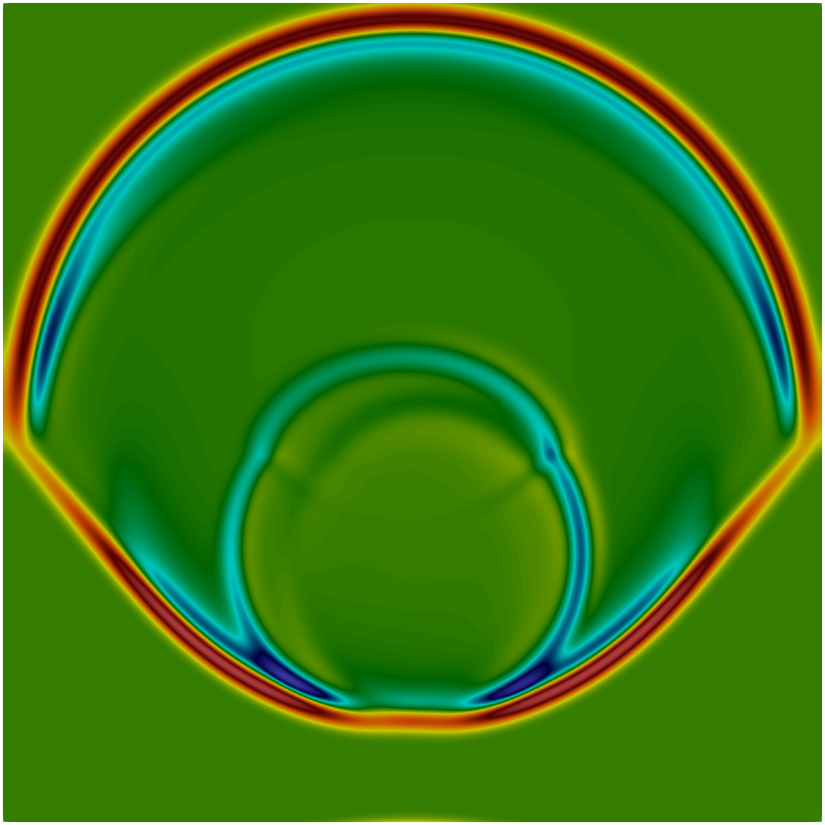
Maxwell’s Equations
sender auto maxwell_eqs(scheduler auto &compute,
grid_accessor A, …) {
return repeat_n(n_outer_iterations,
repeat_n(n_inner_iterations,
schedule(compute)
| bulk(G.cells, update_h(G))
| halo_exchange(G, hx, hy)
| bulk(G.cells, update_e(time, dt, G))
| halo_exchange(G, hx, hy))
| transfer(cpu_serial_scheduler)
| then(output_results))
);
}
Notes:
We’ve developed a prototype of senders that supports CPU schedulers, GPU schedulers, and distributed schedulers.
This simple electromagnetic wave simulation solves Maxwell’s Equations on a uniform grid. This is the entire solver loop, which is expressed as a graph of senders.
SOURCE: https://github.com/brycelelbach/wg21_p2300_std_execution/tree/cuda_graph/examples/cuda/example/maxwell

Slide 48
Maxwell’s Equations
Change one line of code and scale from a single CPU thread…
sync_wait(maxwell_eqs(cpu_serial_scheduler), …);
Georgy Evtushenko (NVIDIA), Gonzalo Brito (NVIDIA)
Notes:
This code can be run with a variety of different schedulers.
By changing just one line of code – the kind of scheduler passed to the solver – we can go running inline on a single CPU thread…

Slide 49
Maxwell’s Equations
Change one line of code and scale from a single CPU thread up to multiple CPU threads…
sync_wait(maxwell_eqs(cpu_parallel_scheduler), …);
Georgy Evtushenko (NVIDIA), Gonzalo Brito (NVIDIA)
Notes:
…to running in parallel on the CPU using OpenMP…

Slide 50
Maxwell’s Equations
Change one line of code and scale from a single CPU thread up to a GPU…
sync_wait(maxwell_eqs(single_gpu_scheduler), …);
Georgy Evtushenko (NVIDIA), Gonzalo Brito (NVIDIA)
Notes:
…to a single GPU…

Slide 51
Maxwell’s Equations
Change one line of code and scale from a single CPU thread up to multiple GPUs…
sync_wait(maxwell_eqs(multi_gpu_scheduler), …);
Georgy Evtushenko (NVIDIA), Gonzalo Brito (NVIDIA)
Notes:
…to multiple GPUs within a single node…

Slide 52
Maxwell’s Equations
Change one line of code and scale from a single CPU thread up to a cluster of GPUs!
sync_wait(maxwell_eqs(multi_node_gpu_scheduler), …);
Georgy Evtushenko (NVIDIA), Gonzalo Brito (NVIDIA)
Notes:
…and to multiple nodes, scaling up to thousands of GPUs.

Slide 53
Palabos Carbon Sequestration
Palabos is a framework for parallel computational fluid dynamics simulations using the Lattice-Boltzmann method.
Code for multi-component flow through a porous media ported to C++ Senders and Receivers.
Application: simulating carbon sequestration in sandstone.
Jonas Latt (University of Geneva), Christian Huber (Brown University)
Georgy Evtushenko (NVIDIA), Gonzalo Brito (NVIDIA)
Notes:
We’ve ported a simulation from the Palabos fluid dynamics framework to senders. This simulation models carbon sequestration techniques. The porous structure you see is sandstone saturated in salt water. The red bubbles are liquid CO2, which is injected at the bottom & travels through the sandstone because of buoyancy forces.
Using a distributed GPU scheduler, we’ve run this application on up to 512 GPUs. With Standard C++ Senders, you can change one line of code, & scale from a single CPU thread up to an entire cluster of GPUs.

Slide 54
On The Horizon For
Reflection
Pattern Matching
Senders
Notes:
Reflection, pattern matching, and senders.
I believe these are the three most exciting C++ features that we’re working on.
Combined, they’ll radically improve how we express ourselves in C++ and allow us to elegantly solve problems that are challenging today.

Slide 55
HORIZONS
Notes:
Thank you for your time and attention. Come find me later if you want to learn more about or get involved in the development of C++. You can also check out my other talks on YouTube and my podcast, ADSP. Follow me on Twitter!

Slide 56
Thanks
Jeff Garland
Herb Sutter
Andrei Alexandrescu
Louis Dionne
Daveed Vandevoorde
Michael Park
Michał Dominiak
Georgy Evtushenko
Lewis Baker
Lucian Radu Teodorescu
Lee Howes
Kirk Shoop
Michael Garland
Eric Niebler

